Slide 1
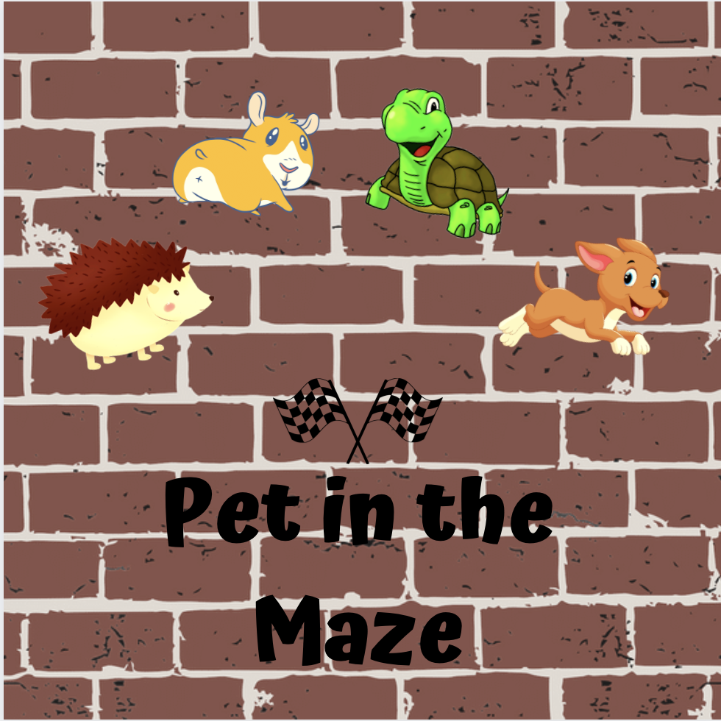
Created by:
Yan Kuang,Haya Alhumaid, Xavier Carrillo,Bowei Tian

Slide 2
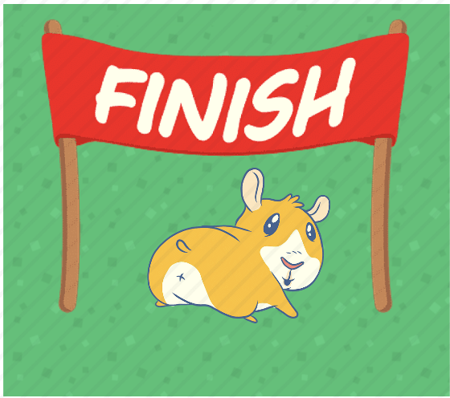
Pet in the Maze
There are many types of shared racing games out there in the marketplace. But we strived to make a fun game that you could play by yourself or a friend that is different than the others and changed the way you play.

Slide 3
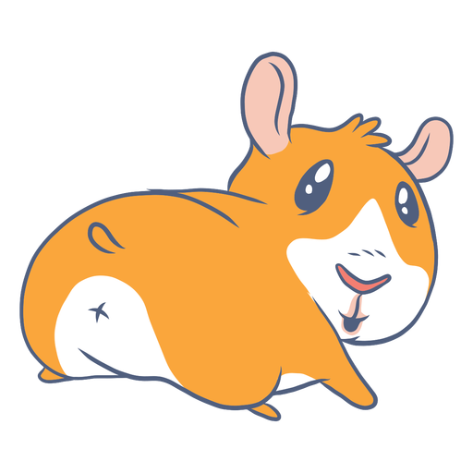
Hamster
The hamsters movement is based on vibrations picked up by the phone. The user lays down their phone and hits around it. The hamster will then run away in the opposite direction.

Slide 4
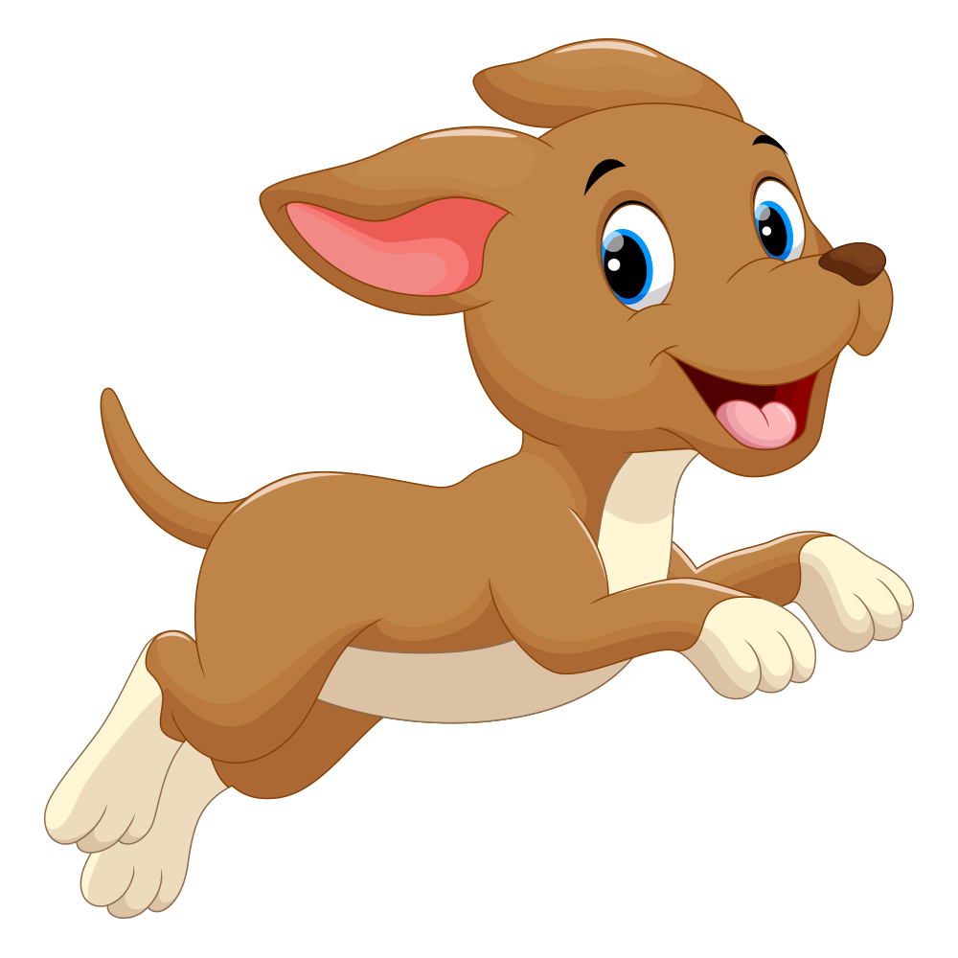
Dog
A lot like an actual dog, the dog will move based on voice commands. The user speaks into the microphone giving commands move up, move down, move left and move right and the dog responds accordingly.

Slide 5
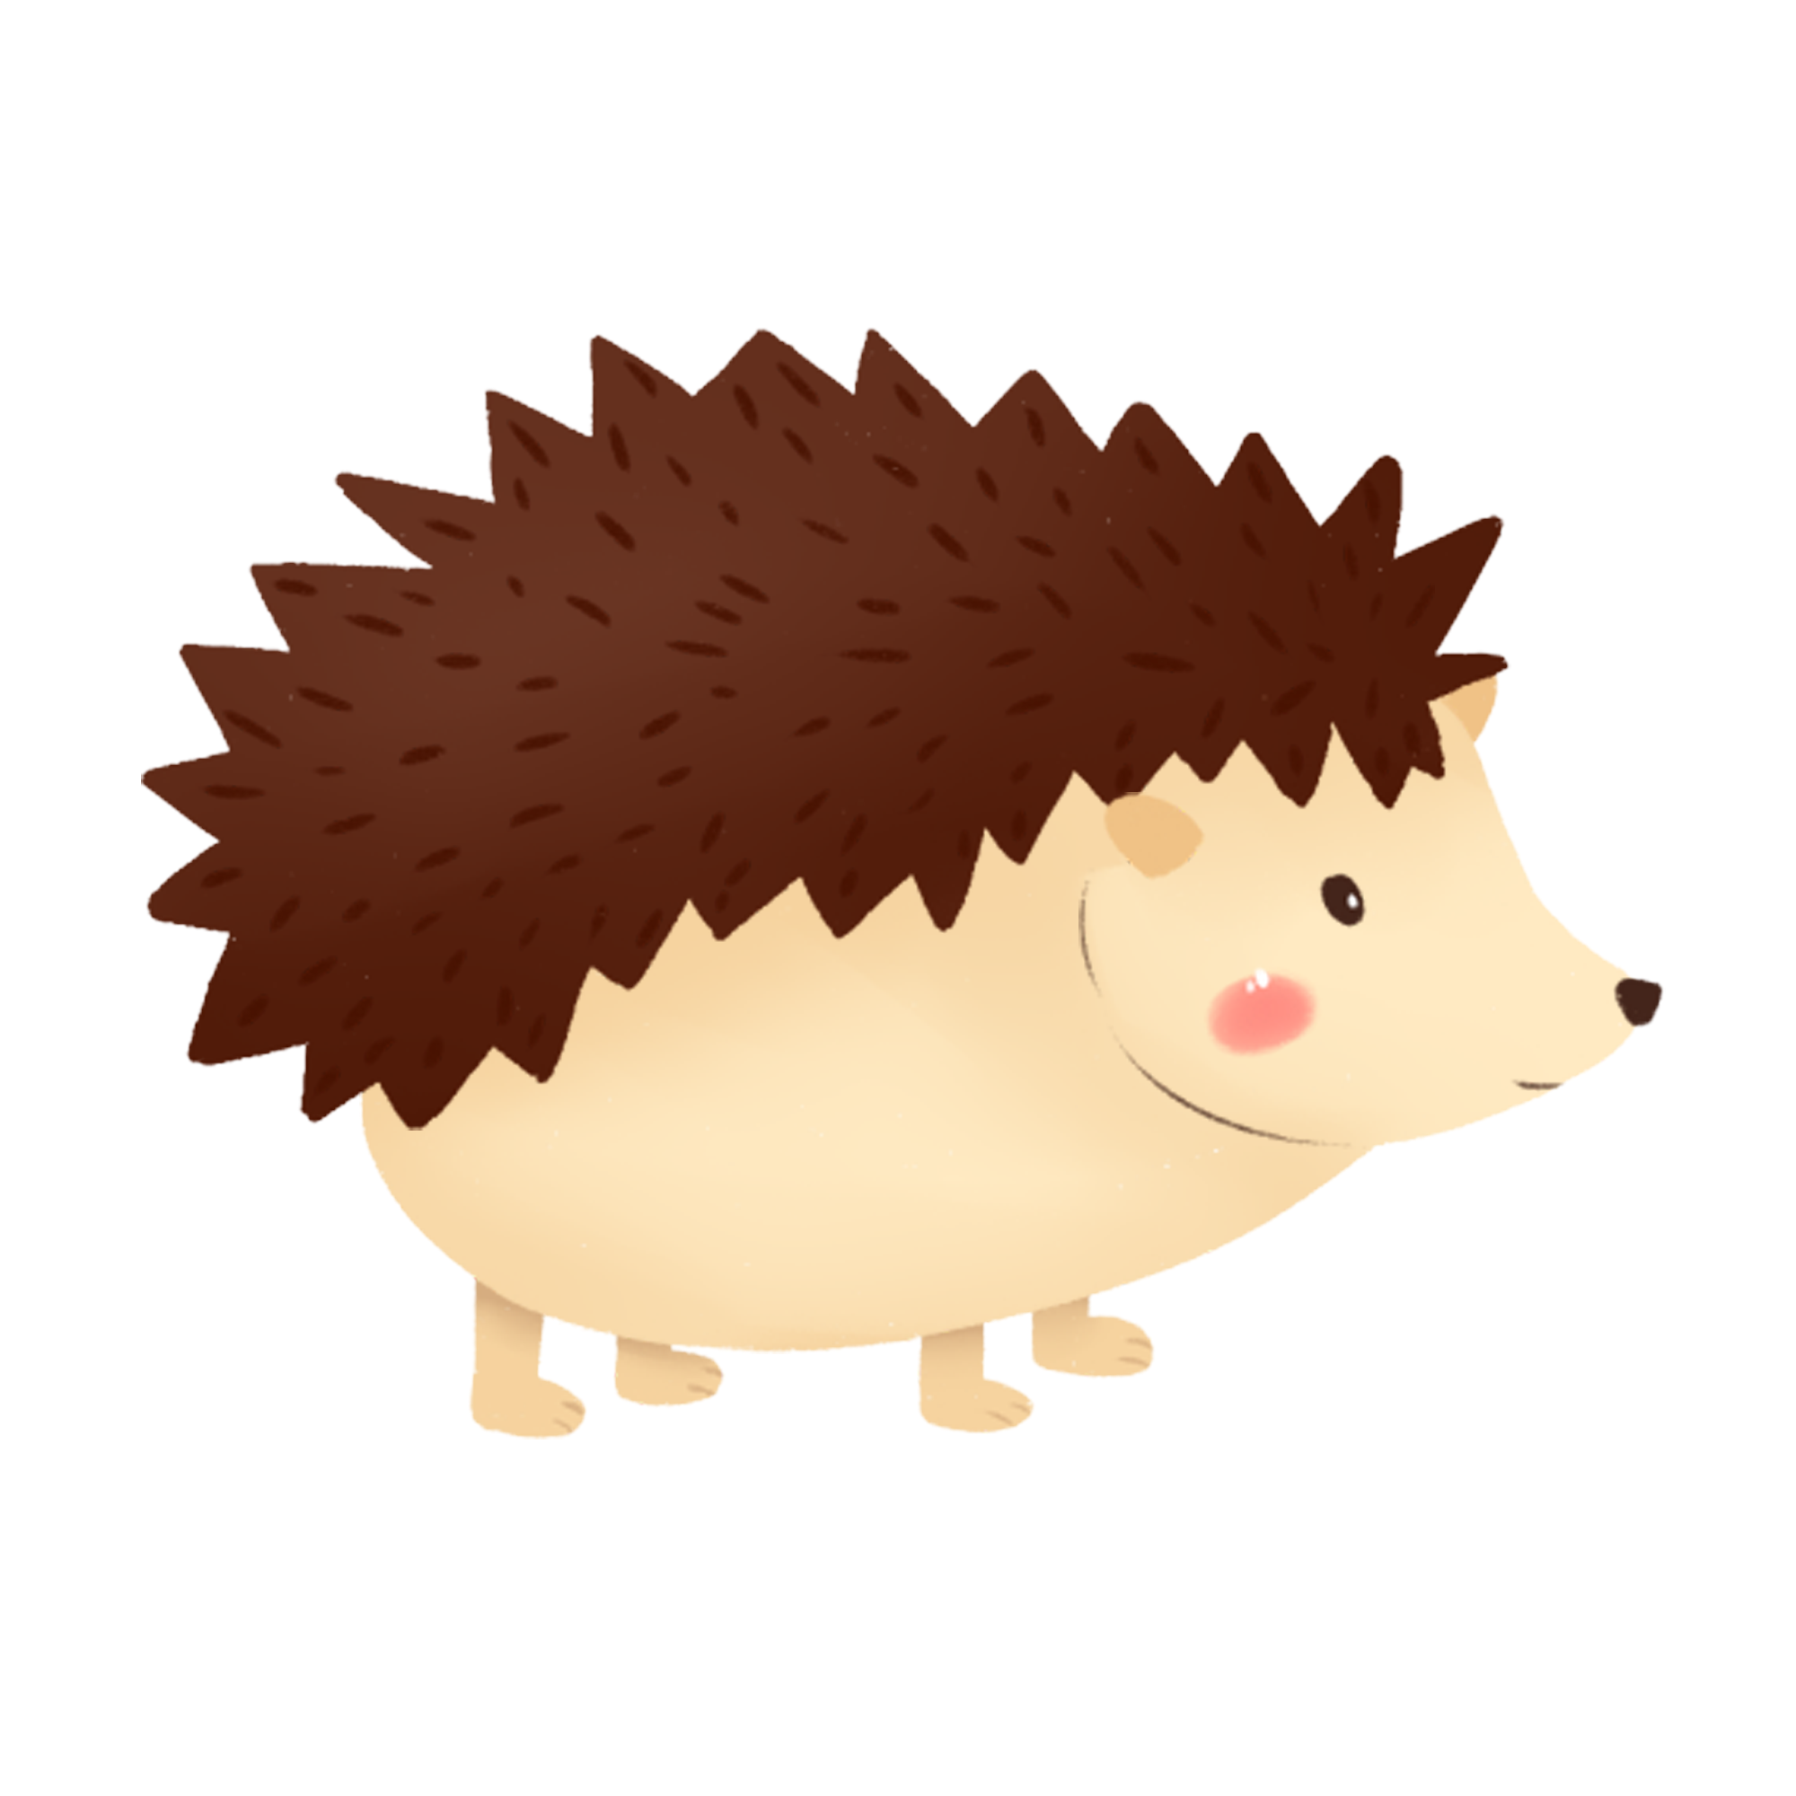
Hedgehog
The hedgehog’s movement is based on rolling in the maze. The user can tilt their phone one direction or the other and the hedgehog will roll based on the angle of the phone.

Slide 6
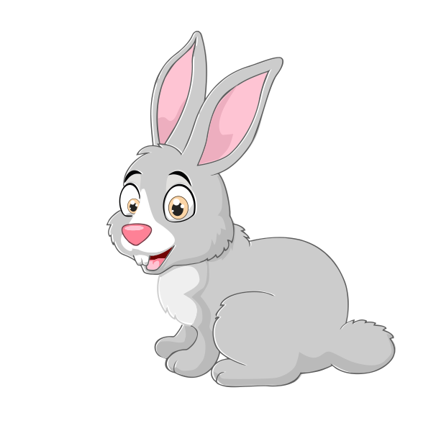
Rabbit
The rabbit will follow the carrot it is offered. In this case that carrot is a magnet, that is held around the phone, with rabbit heading toward the direction of the magnet.

Slide 7
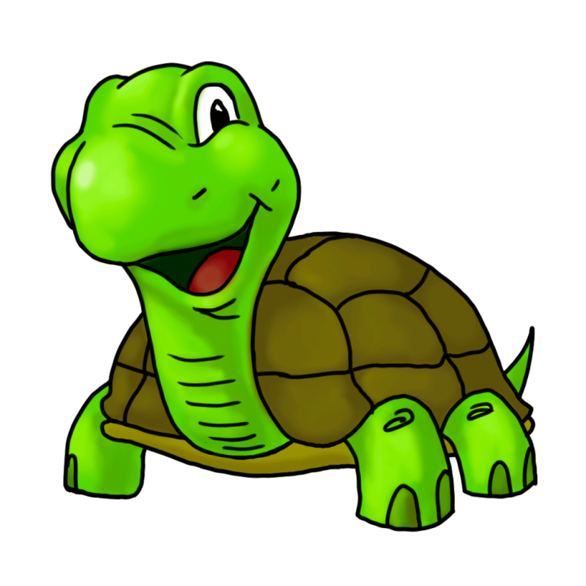
Turtle
The simplest of the five to control but also the slowest, is the turtle. This character is moved by a joystick.

Slide 8
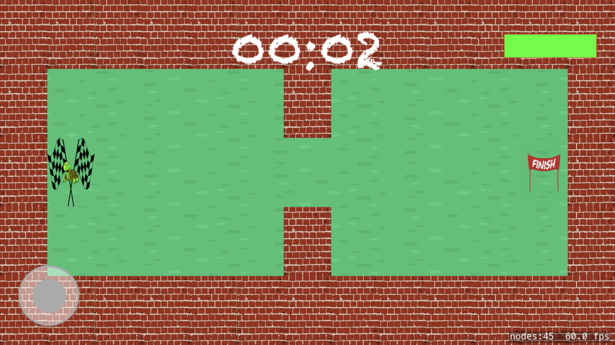
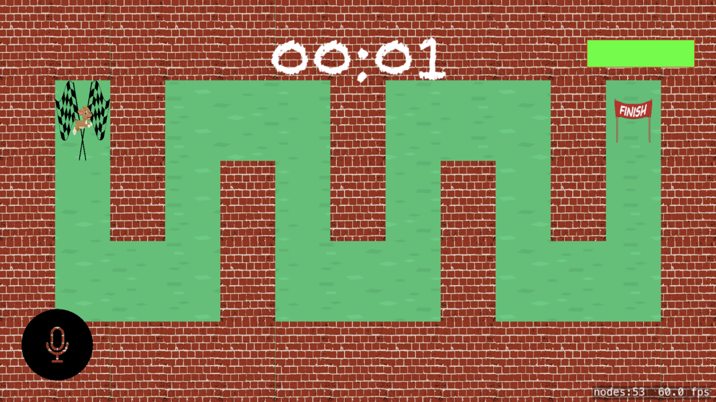
The Maps

Slide 9
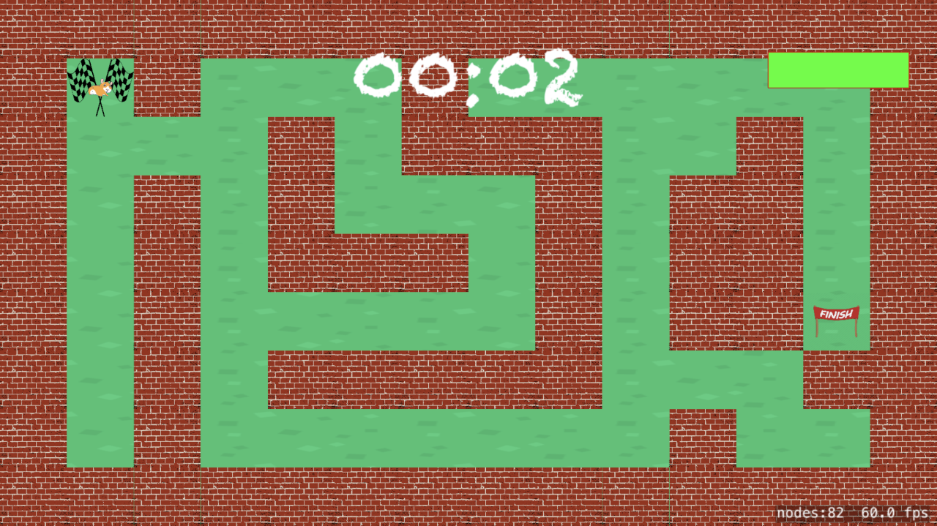
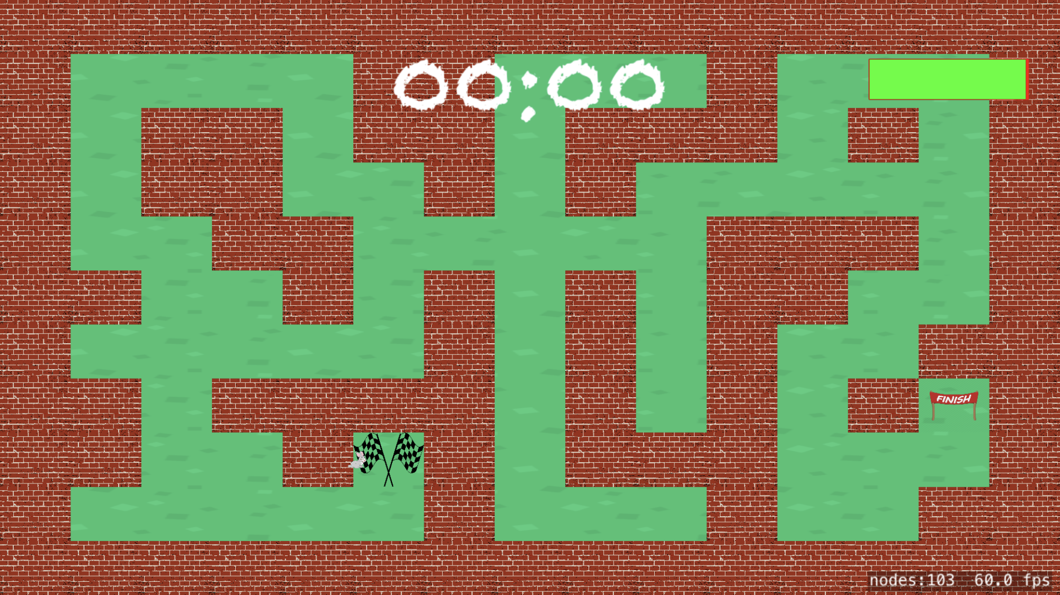
Cont.

Slide 10
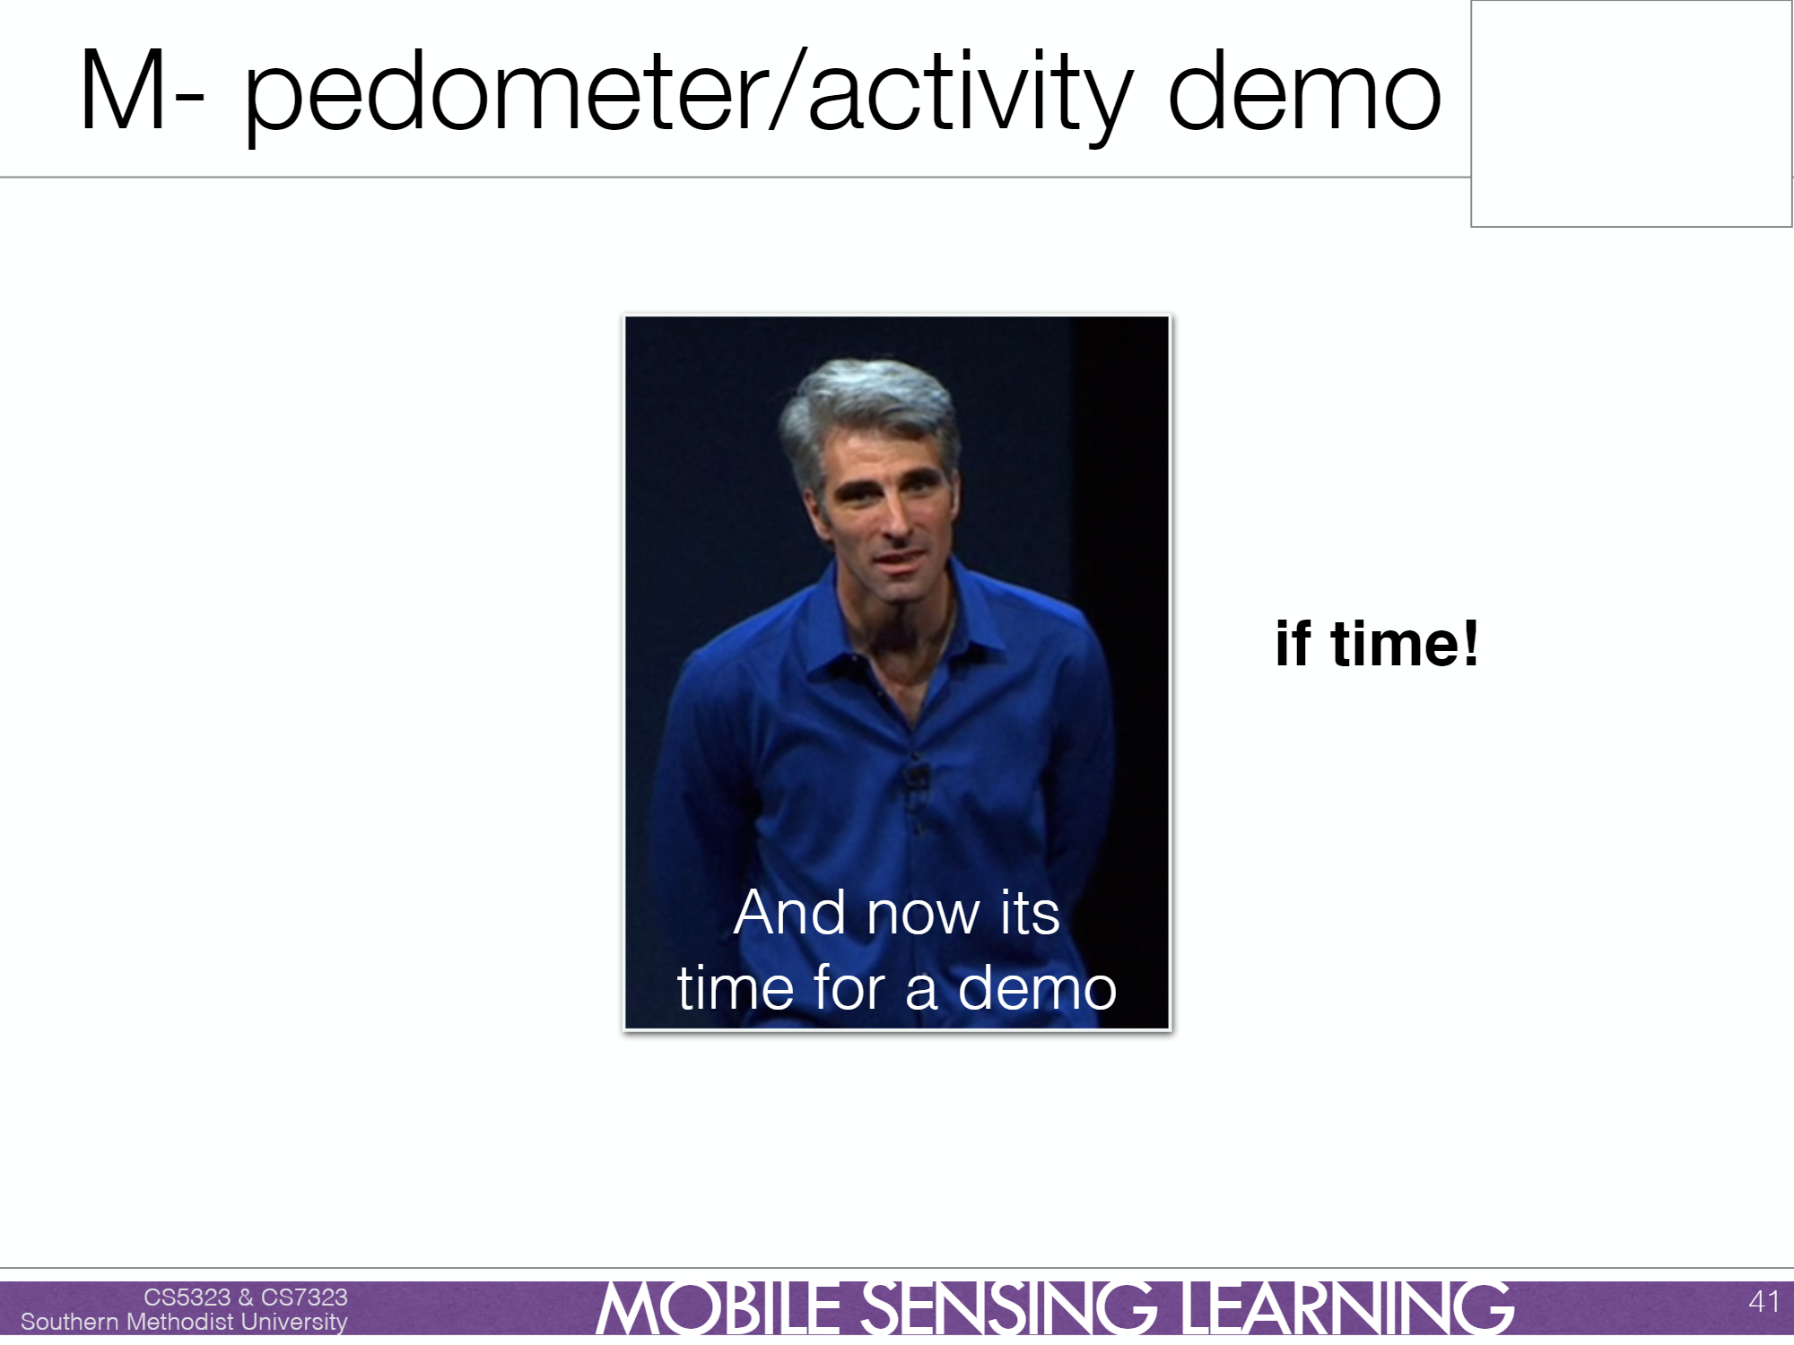
Demonstration

Slide 11
Challenges & Solutions
Machine Learning
Accuracy
Bluetooth Connection
Notes:
There are several challenges we encountered during the development. Besides using the joystick and gravity to control the characters, we also implement speech control, accelerometer control, and magnate control. To let the pets understand all those, we indue them with the “intelligence” by machine learning algorithms.

